Slide 1
Network Science
Going over the Syllabus

Slide 2
Instructor
Name: Evgeny Dantsin
Email: edantsin@roosevelt.edu
Webpage: link to the RU page
Office Location: AUD 336
Office Hours: Mon/Wed: 9:15 am – 10:45 am. Please email me a day in advance to make an appointment.

Slide 3
What Is the Course About?
Types of real-world networks:
social networks;
technological networks;
networks of information;
biological networks.
Major topics:
the measurement of networks (centrality, similarity, etc.);
properties of real-world networks (small world, long tails, etc.);
models of network formation (rich-get-richer models);
models of processes taking place on networks (diffusion, epidemics, etc.)

Slide 4
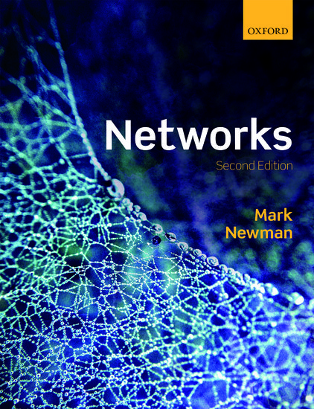
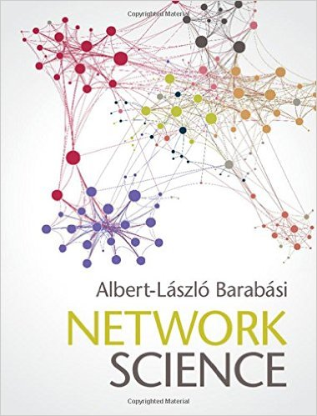
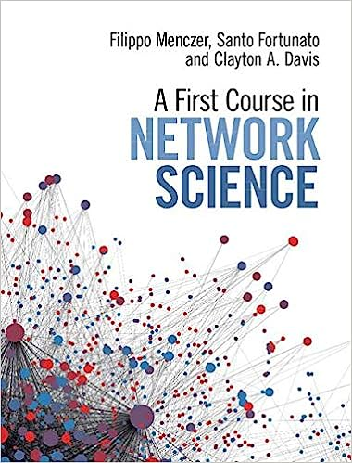
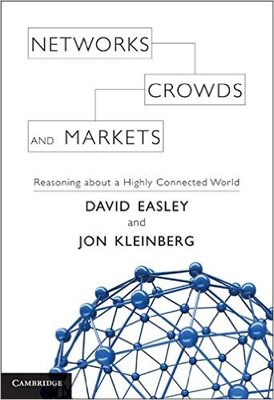
Books
The most complete book on networks, but some sections require high-level mathematics.
A good book, but some important aspects of networks are not covered at all.
A good book, but it covers only the very basics. Some topics are just outlined.
One of the first books on networks (2010). New themes appeared after its publication.

Slide 5
Schedule
centrality
similarity
properties of real-world networks
processes on networks

Slide 6
Presentations (for Graduate Students Only)
Coursework includes an independent study component where students learn advanced topics in network science.
The results are summarized in group presentations about 25 minutes long (typically, in a group of two or three students). Each student is required to participate in such a group presentation.
Students choose topics of their presentations and discuss them with the instructor during October.

Slide 7
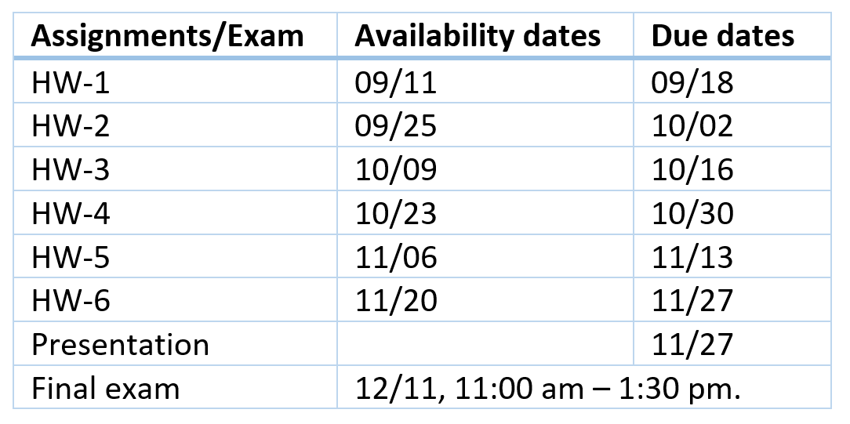
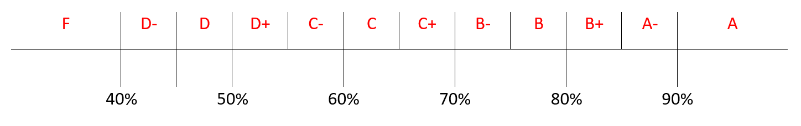
Grading
There will be six homework assignments, class presentations (for graduate students only), and a final exam.
Notes:
The percentage of points earned on the assignments, presentations, and exam determines the final grade. This percentage is converted into the letter grade according to the scale below:

Slide 8
